Slide 1

Car Rental System
1.Mayur Jain (20104024)
2.Madhur Dukhande (20104014)
3.Aryan Amin (20104071)
Project Guide
Ms. Apeksha Mohite

Slide 2
Contents
Introduction
Objectives
Scope
Features / Functionality
Project Outcomes
Technology Stack
Block Diagram if applicable

Slide 3
1. Introduction
Automated Car Rental Portal is an application , which provides a lot of facility to their business.
It will record the details of various activities of customers as well as information about booking.
Problem Identified :
    People get too many complications regarding subscriptions.
    In order to offers cars for rent, a car owner normally have to come to the nearest branch office to register car to be rent out.
Solution Proposed :
The subscriptions given have been simplified and
After developing car rental based application it becomes easy to register a car for rent or to buy a car for rent People can buy or rent a car from any place

Slide 4
2. Objectives
Write objectives of selected project topic in numbers like
To Provide friendly and reliable customer service in order to establish a loyal customer base.
To Make the customer aware that hiring a car is the next best option to buy a car.
To Effectively promote our service to a wide range of corporates.
To Provide best service ensuring comfortable, safe, reliable & timely service.
To Providing cost effective transport solution to the client.
To Achieve continuous improvement in customer satisfaction.

Slide 5
3. Scope
Write Scope of selected project topic in numbers like
The car rental system to keep detail records of both the cars and the customers, the duration they rent car as well as the type of car they rent.
The system will be mainly design for small a company that renders it car rental services to customers.
The system will have the ability to generate and print invoice for each successful transaction.

Slide 6
4. Feature /Functionality
Write all the features & Functionality you are planning to implement
1. Facilitate automated check-in and checkout :
Booking management is the most basic function of a car rental software. The application should be advanced enough so that the client can make online reservations instead of physically taking efforts
2. Allow online cancellation :
It should also ensure that both the company as well as the customer are on the same page concerning the ride. It should also look into penalizing a consumer if there are repeated, unjust cancellations.
3. Should facilitate dynamic pricing; allow comparison :
The car tracker should be able to list the rental prices under one table, making it easier for the customers to find their desired vehicle. It should also be able to adjust the rent according to demand, high season rates or promotional prices.

Slide 7
5. Outcome of Project
New User can register through registration page.
User can view car booking history.
User can find car details and book a car.
User can check booking status.
User can add a note regarding their preferences.

Slide 8
6. Technology Stack
Write what you have planned to develop front end ( GUI ) & Backend (Database if applicable)
Back End:
MYSQL Ver 8.0.26
Front End:
1. Java ver 16.0.1

Slide 9
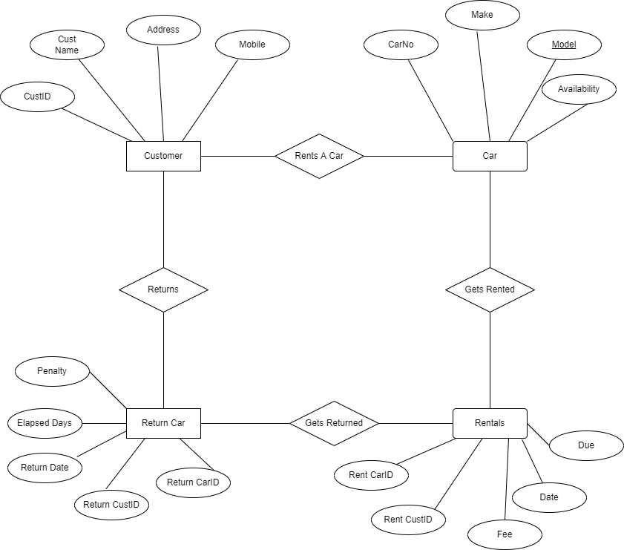
7. Block Diagram ( if applicable)

Slide 10
Thank You...!!

